Slide 1


CodeLab
One stop destination for competitive programmers
Notes:
Teal - #63B8A7
Blue – 09427D
color wheel, causing there is no clear dominance of one color. The colors have equal distance between each other.
#63B8A7
#A763B8
#B8A763

Slide 2





Features
Code in 20+ languages like C, C++, Java, Python
C++
Home
Colleges
Large rated Question set available
Ques
Rank
Get Leader-board Insights and Ranking
Master Problem solving skills from home, school, college or anywhere
Code freely from anywhere
Notes:
Market size + customer profile(segment) (phlux slide 7)

Slide 3




Tech Stack
Front END
Back END
HTML / CSS / JS
React JS
Node JS
MySQL

Slide 4
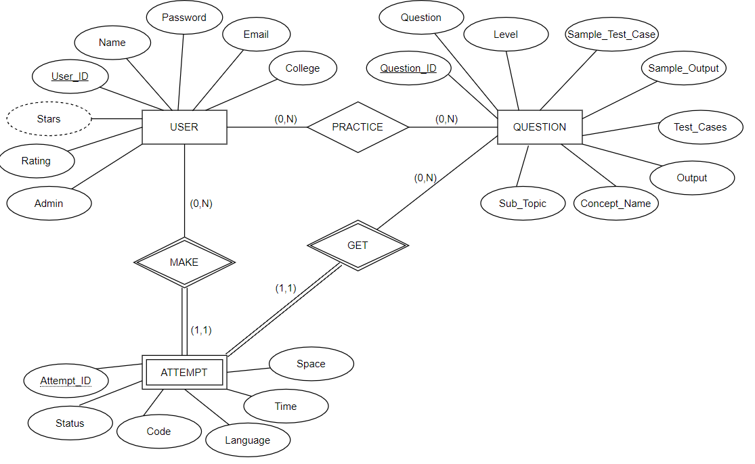
ER Model

Slide 5
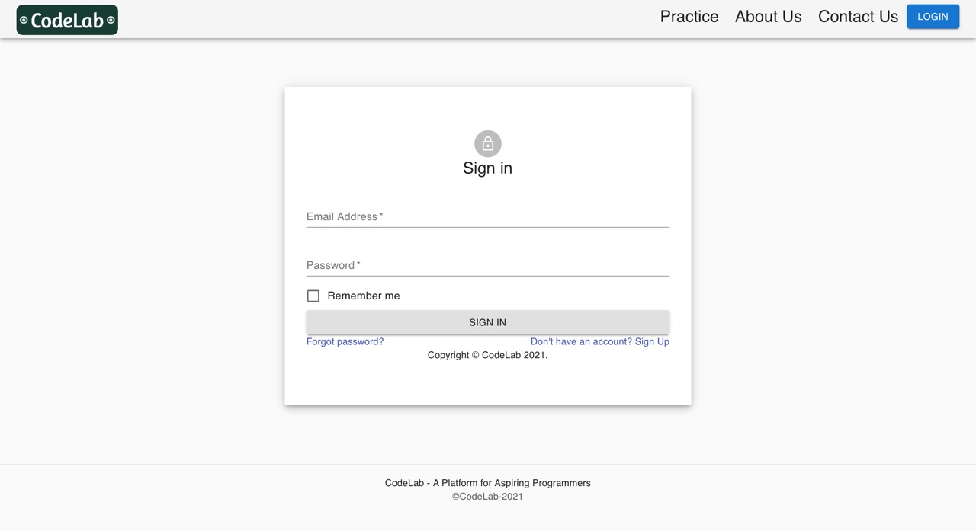
User Interface

Slide 6
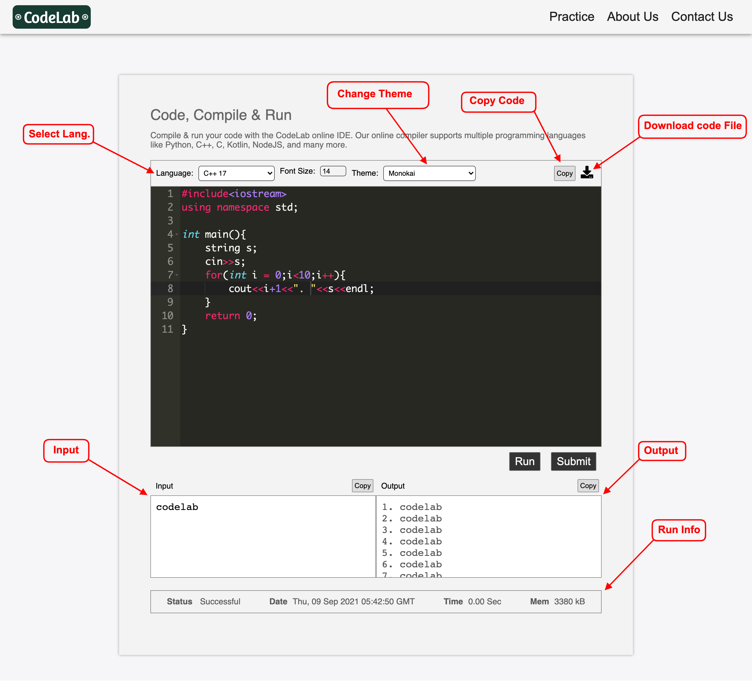

Slide 7
THANK YOU

